Slide 1
Kinetic particle model, Temperature and heat
Year 11 physics

Slide 2
Kinetic particle model
Used to explain the states of matter (solid, liquid, gas).
All matter is made up of small particles that are in constant motion (they have kinetic energy).

Slide 3
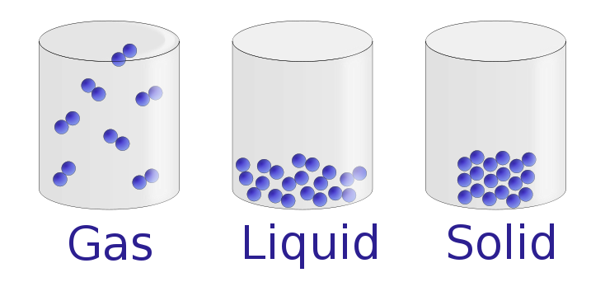
Kinetic particle model

Slide 4
Kinetic particle model
Solid –
Particles are attached to each other by bonds (a bit like springs).
The solid material has potential energy because of these bonds.
Even in a solid the atoms are all vibrating and moving constantly. The particles therefore have kinetic energy.

Slide 5
Kinetic particle model
Liquid –
Particles very loosely bound.
Still potential energy associated with interactions between the particles but less than in a solid.
The particles typically have much more kinetic energy.

Slide 6
Kinetic particle model
Gas –
Bonds between particles have broken and they are free to move.
No longer potential energy associated with bonds between particles.
Particles are in constant motion. They interact by colliding and undergoing elastic collision, transferring kinetic energy from one particle to another.

Slide 7
Kinetic vs potential
Kinetic energy – the energy a body possesses due to its motion (movement energy).
Potential energy – the energy stored in an object due to its position relative to some zero position (stored energy).

Slide 8
Diffusion
Diffusion is the movement of particles from a high concentration to a low concentration.
Rapid in gases and slower in liquids.
Helps to illustrate the kinetic particle model.

Slide 9
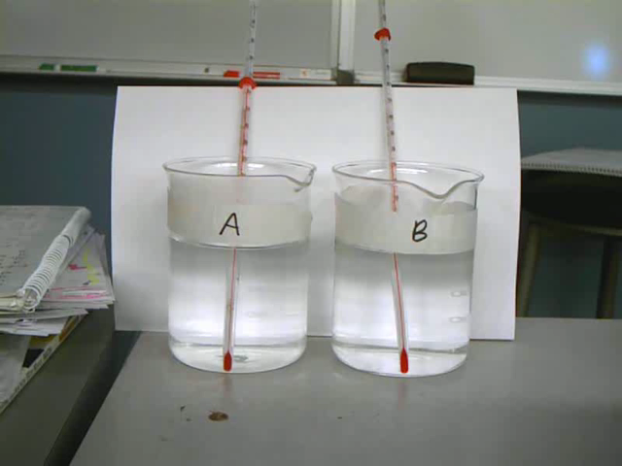
A – Hot water B – Cold Water

Slide 10

Temperature vs heat

Slide 11
Temperature vs heat
Heat is thermal energy transferred from a hotter system to a cooler system (measured in Joules).
Temperature is a measure of the average kinetic energy of the particles in a system (measured in degrees Celsius or Kelvin).
Thermal energy is the total amount of kinetic energy of the particles in a system (measured in Joules).

Slide 12
Thermal Equilibrium
It is observed that a higher temperature object which is in contact with a lower temperature object will transfer heat to the lower temperature object. The objects will approach the same temperature, and in the absence of loss to other objects, they will then maintain a constant temperature. They are then said to be in thermal equilibrium.
Thermal equilibrium is the subject of the ”Zeroth Law of Thermodynamics”.

Slide 13

Specific heat capacity
How much energy does it take to heat water?

Slide 14
Specific heat capacity
The specific heat capacity tells us the amount of energy needed to raise the temperature of 1kg of a substance by 1 K (1˚C).
E.g. water has a high specific heat capacity in comparison to cooking oil. Therefore cooking oil will heat up and cool down quicker than water as it requires less energy to do so.

Slide 15
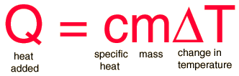
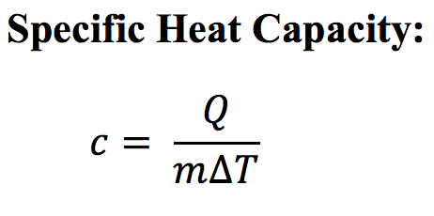
Specific Heat Capacity is measured in J/kg/K.

Slide 16
Specific heat capacity example
Calculate the energy needed to increase the temperature of 2kg of water from 2˚C to 100˚C. The specific heat capacity of water is 4200 J/kg˚C.

Slide 17
Specific heat capacity example
A hot water bottle cools down from 80˚C to 20˚C, releasing 750000 J of energy. Calculate the mass of the water in the hot water bottle. The specific heat capacity of water is 4200J/kg/K.
SOLUTION
Ti = 80 ˚C Tf = 20 ˚C ΔT = Ti – Tf = 80 – 20 = 60 K
C = 4180 J/Kg/K Q = 750000 J m = ?
Q = m C ΔT
750000 = m x 4180 x 60
m = 750000/(4180 x 60)
= 2.99 kg

